Slide 1

Health care
analytics
- Guttameedi Manasa

Slide 2
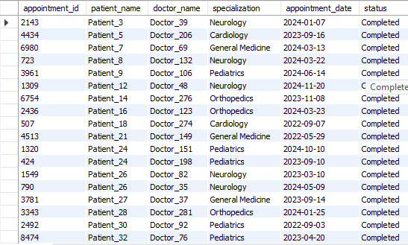
APPOINTMENTS STATUS
Implemented joins and Filter conditions.
3392 appointments were completed out 0f 10000.

Slide 3
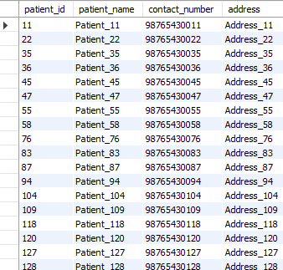
Patients who never had an appointment.
Used Left join with null handling values.
662 patients don’t have any appointments out of 5000.

Slide 4
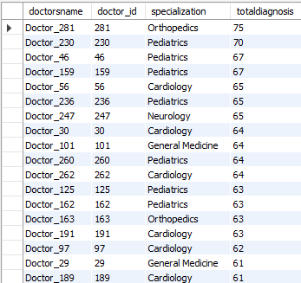
Total number of diagnosis for each doctor.
Utilized joins and aggregate functions.
Doctor_281 had highest number of diagnosis i.e 75.
There is no doctor who haven’t diagnosed any patient.

Slide 5
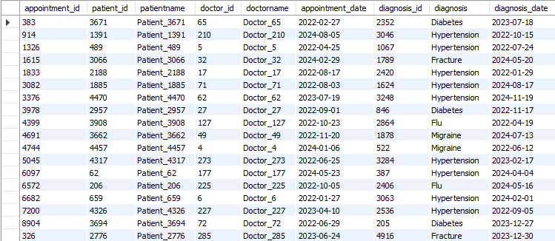
Mismatches between appointments and diagnosed table.
Executed join function to compare the tables.
No mismatches were found.

Slide 6
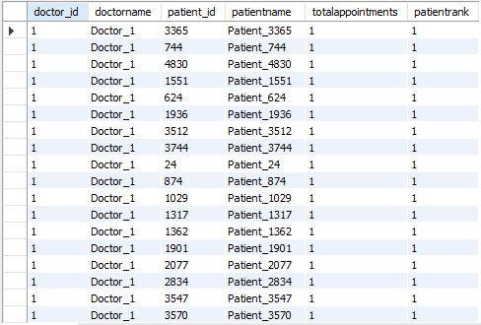
Ranking patients of each doctor on the number of appointments
Applied ranking functions such as rank.
36 patients having more than 1 appointment out 0f 10000.

Slide 7

Number of patients in each age group.
Categorised patients with CASE function into age groups.
Age group 51+ is having highest patients.

Slide 8

Patients whose contact number ends with 1234.
Displayed patient name in upper case.
Used string functions like UPPER and LIKE.
Only 1 patient having contact number ends with 1234.

Slide 9
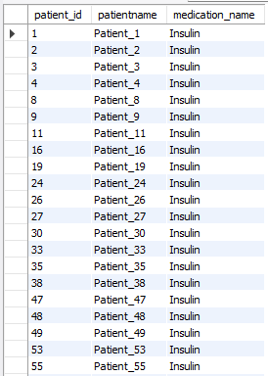
Patients who have only been prescribed “INSULIN” in any of their diagnosis.
Implemented subqueries for advanced filtering.
1784 Patients has been prescribed with “INSULIN”.

Slide 10
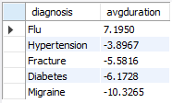
Average duration for which medications are prescribed for each diagnosis.
Worked with data functions like DATADIFF.
Only “FLU” is having the positive avg. duration.

Slide 11
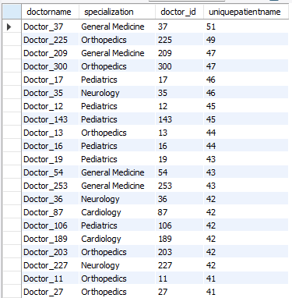
Doctors who has attended the most unique patients.
Combined Count(distinct), joins and group.
Doctor_37 has attended the most unique patients.

Slide 12


